Slide 1
Welcome!
Question of the Day:
TBD
‹#›

Slide 2
5.3 The Boolean Type
PROFESSOR RAMSEY
GDC 6.318
ramsey@cs.utexas.edu
Notes:
need clicker checks

Slide 3
Announcements
TBD

Slide 4
??? Quiz

Slide 5
5.3
The Boolean Type
Notes:
Session Title: Project Based Learning (PBL) for Equity in CS classes
Session Description: If you are teaching a survey course like Computer Science Principles, or a code intensive course like AP CS A, PBL can serve as a powerful tool to increase student interest and engagement. Learn about research that connects PBL to improved student outcomes, especially for girls and underrepresented minorities. Discover available PBL resources and understand PBL lesson components, so you can build your own.

Slide 6
Methods That are Tests
Some methods return logical values. A call to such a method can be used as a test in a loop or if.
Scanner console = new Scanner(System.in);
System.out.print("Type your first name: ");
String name = console.next();
if (name.startsWith("Dr.")) {
System.out.println("Will you marry me?");
} else if (name.endsWith("Esq.")) {
System.out.println("And I am Ted 'Theodore' Logan!");
}
WARNING: This is a ridiculous example. I left it in as ridiculous on purpose.

Slide 7
More String Methods
String methods with boolean returns:

Slide 8
String Equality
Why do we need equals?
String1 = “Hi!”;
String 2 = “Howdy”;
if (String1 == String2)
// this is 6F34AB == 6F34C6
String1, 6F34AB
Index | Character
0 | ‘H’
1 | ‘i’
2 | ‘!’
String2, 6F34C6
Index | Character
0 | ‘H’
1 | ‘o’
2 | ‘w’
3 | ‘d’
4 | ‘y’

Slide 9
Type Boolean
boolean: A logical type whose values are true and false. You can
create a boolean variable
pass a boolean value as a parameter
return a boolean value from methods
call a method that returns a boolean and use it as a test
boolean minor = age < 18;
boolean isProf = name.contains("Prof");
boolean lovesCSE = true;
// allow only CSE-loving students over 21
if (minor || isProf || !lovesCSE) {
System.out.println("Can't enter the CS student club!");
}

Slide 10
Using Boolean Variables
WARNING: This is a ridiculous example. I left it in as ridiculous on purpose.
Why is type boolean useful?
Can capture a complex logical test result and use it later
Can write a method that does a complex test and returns it
Makes code more readable
Can pass around the result of a logical test (as param/return)
boolean goodAge = age >= 12 && age < 29;
boolean goodHeight = height >= 78 && height < 84;
boolean rich = salary >= 100000.0;
if ((goodAge && goodHeight) || rich) {
System.out.println("Okay, let's go out!");
} else {
System.out.println("It's not you, it's me...");
}

Slide 11
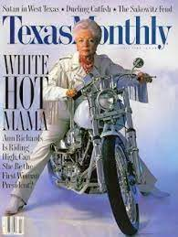

Slide 12
demo1()
Write isPrime() method.
Demo

Slide 13
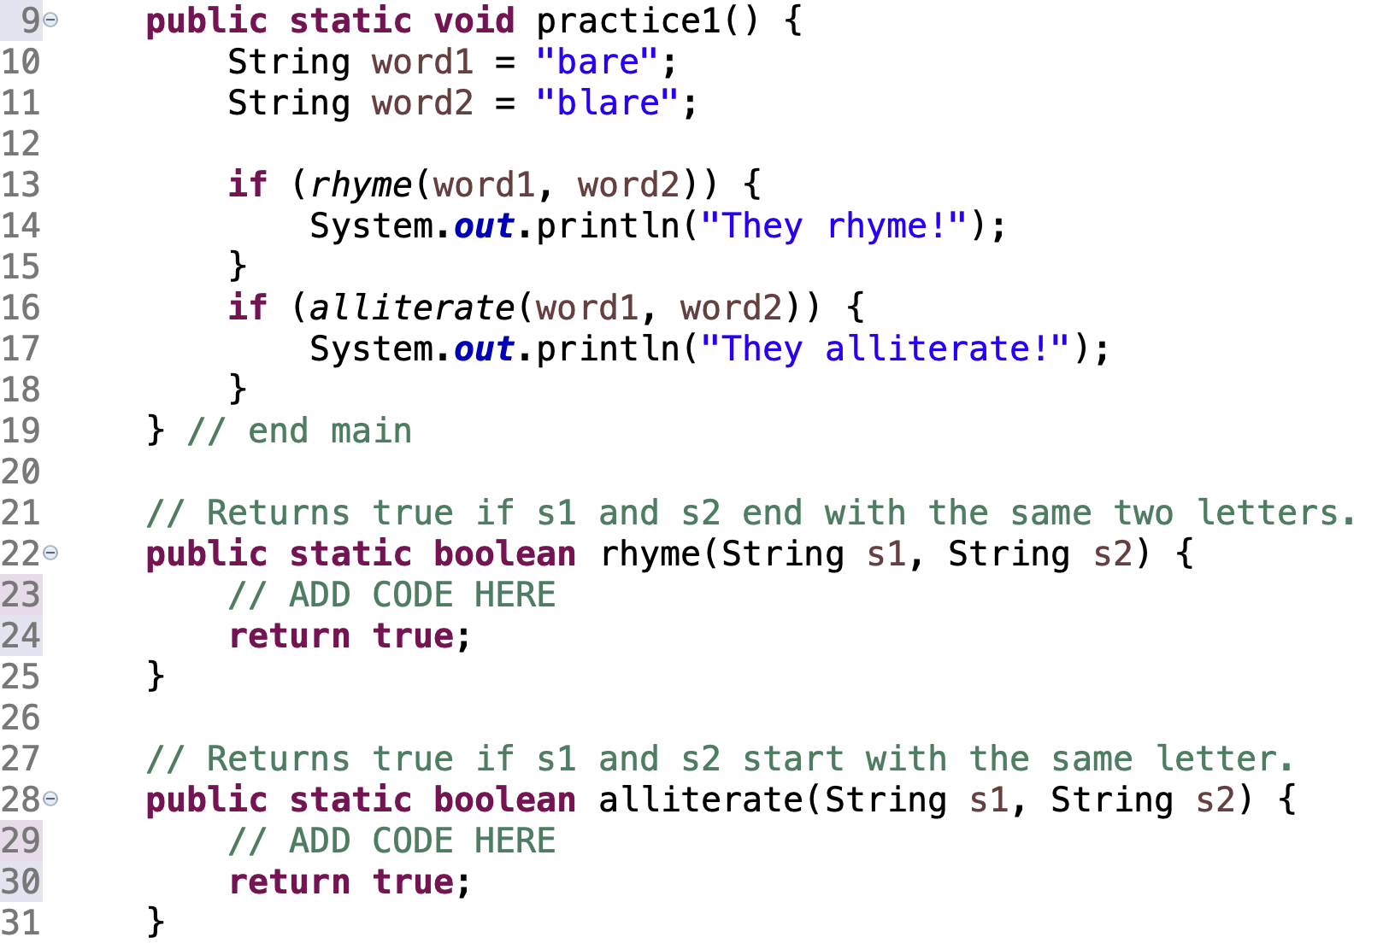
In-Class Practice
practice1()
write two boolean methods

Slide 14
Demo
Boolean Zen
Demo3() - If
Demo4() - for
https://courses.cs.washington.edu/courses/cse143/20sp/style/zen/#boolean-zen

Slide 15
Short-Circuit Evaluation (reminder)
Java stops evaluating a test if it knows the answer.
&& stops early if any part of the test is false
|| stops early if any part of the test is true
The following test will crash if s2's length is less than 2:
// Returns true if s1 and s2 end with the same two letters.
public static boolean rhyme(String s1, String s2) {
return s1.endsWith(s2.substring(s2.length() - 2)) &&
s1.length() >= 2 && s2.length() >= 2;
}
The following test will not crash; it stops if length < 2:
// Returns true if s1 and s2 end with the same two letters.
public static boolean rhyme(String s1, String s2) {
return s1.length() >= 2 && s2.length() >= 2 &&
s1.endsWith(s2.substring(s2.length() - 2));
}

Slide 16
Negating Boolean Tests
De Morgan's Law: Rules used to negate boolean tests.
Often easier to express the exit condition. You could negate the whole thing, but better to simplify the boolean expression.
Clues:
|| conditions are true ¾ cases
&& expressions are true ¼ cases

Slide 17
DeMorgan’s Law
De Morgan's Law: Rules used to negate boolean tests.
Switch || and &&
Negate each value (!a becomes a and a becomes !a)
Example:
Original Expression | Simple Negate | Preferred
a && b | !(a && b) | !a || !b
a || b | !(a || b) | !a && !b
Original Expression | Simple Negate | Preferred
(x == 7 && y > 3) | !(x == 7 && y > 3) | (x != 7 || y <= 3)

Slide 18
In-Class Practice
Practice DeMorgan’s Law
# | Original | Converted
1 | !(x < 3 || y > 2)
2 | !(x < 3 && y > 2)
3 | !(x <= 5 && y > 7)
4 | !((x < 5) || (x > 5) || (y > 7) || (y < 7))
# | Original | Converted
 |  | x >= 3 && y <= 2
 |  | x >= 3 || y <= 2
 |  | x > 5 || y <= 7
 |  | a) !((x != 5) || (y != 7)) b) (x == 5) && (y == 7)

Slide 19
In-Class Practice
// [PIE 5.18]
// Method A: digitSum()
// Parameter: int num, any integer
// Return: the sum of the digits in num
// Example: num = 618, returns 15
// [PIE 5.23]
// Method B: hasAnOddDigit()
// Parameter: int num, any integer
// Return: true if one or more odd digits in num // Example: num = 600, returns false, num = 601, returns true
// PIE 5.22
// Method C: allDigitsOdd()
// Parameter: int num, any integer
// Return: true of all digits odd, otherwise false
// Examples: num = 7932, returns false, num = 3197, returns true
// PIE 5.24
// Method D: allVowels()
// Parameter: String str, any string
// Return: true if all characters are vowels (‘a’, ‘e’, ‘i’, ‘o’ or ‘u’), otherwise false
// Examples: str = “oieauoo”, returns true

Slide 20
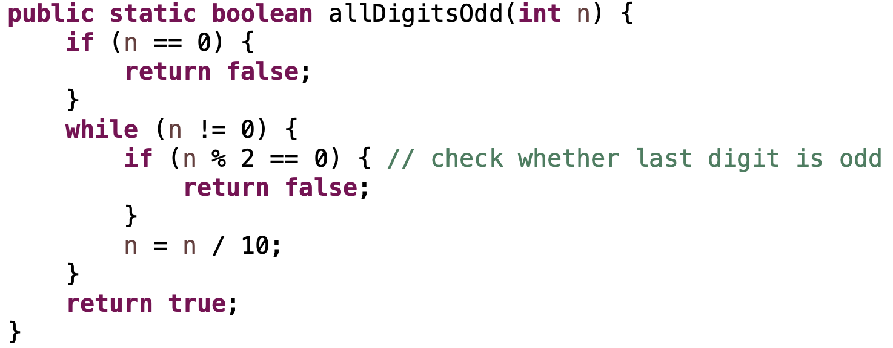
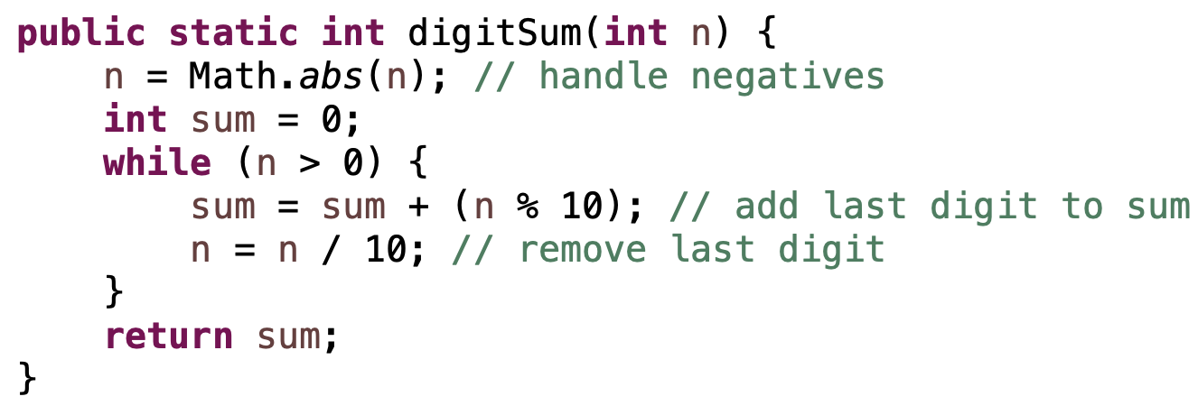
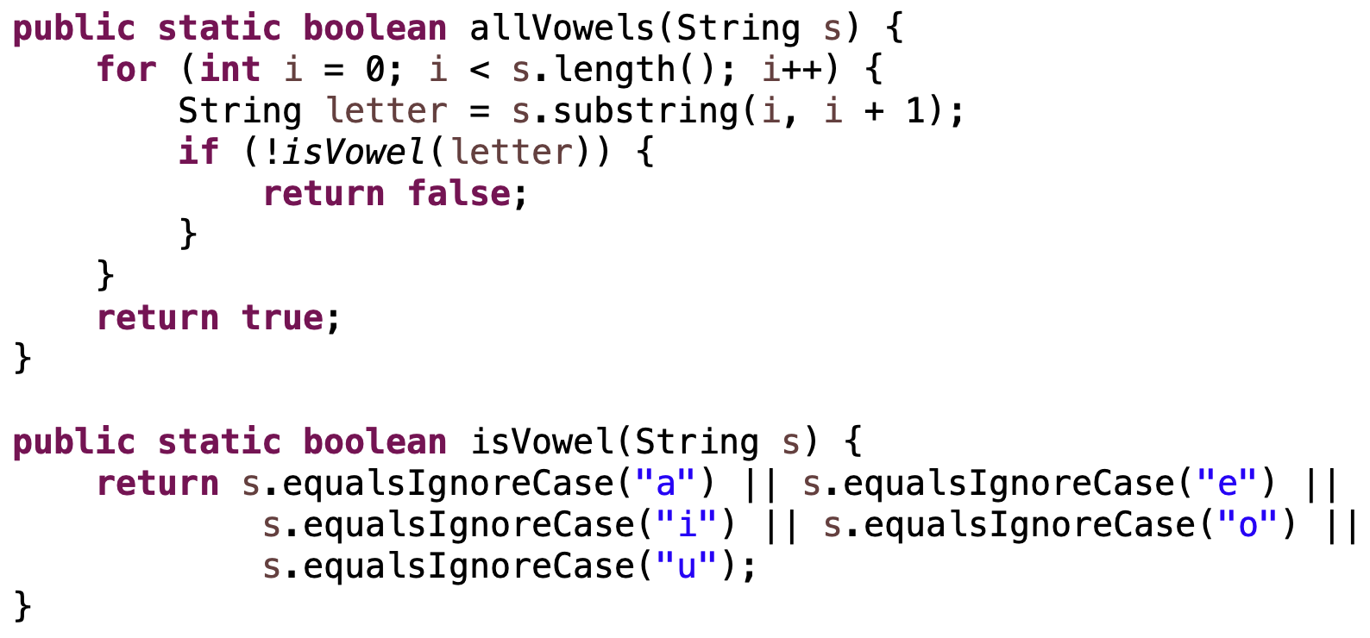
Solutions

Slide 21
Remember
You Belong Here
TBD
Hi!

